Slide 1
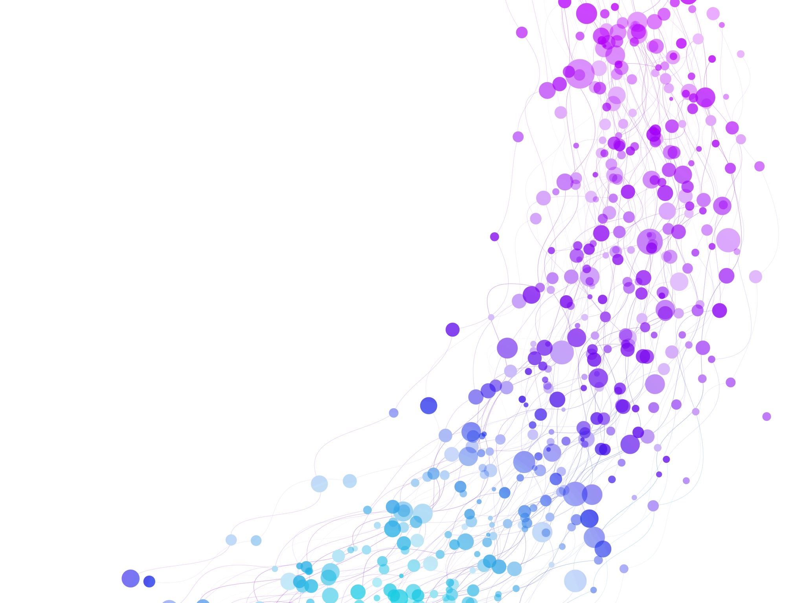


Array: Single and Multidimensional Arrays, Representation of Arrays: Row Major Order, and Column Major Order Session No.: 4 Course Name: Data Strucutres Course Code: R1UC308B Instructor Name: Dr. Gaurav Agarwal Duration: 50 mins Date of Conduction of Class: 28 Aug 2025

Slide 2

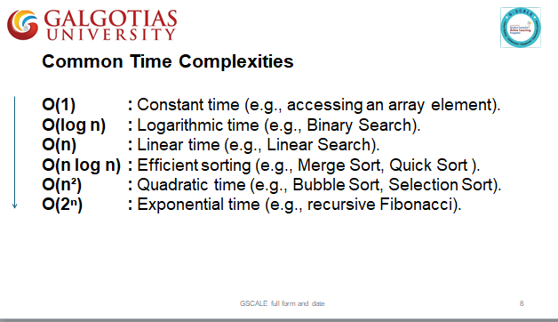
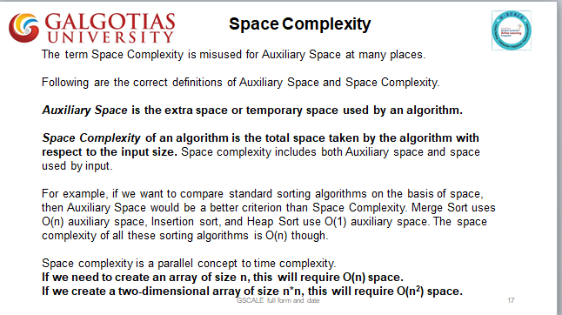
Review

Slide 3

Pre-Class Assessment
[2-mins]
https://app.wooflash.com/moodle/RNATMC3Y
Wooflash Code: RNATMC3Y
Join the link and Participate in Pre-class Assessment

Slide 4

[3-mins]
Imagine you are writing a program that will store 100 students marks of one subject (English)and you must find out the average score of the students in the English. Are you going to store the marks in 100 Variables?

Slide 5
Learning Outcomes
[2-mins]
By the end of this session, You will be able to:
Explain single and multidimensional arrays with examples
Differentiate row-major and column-major array representation

Slide 6
Session Outline
Introduction to Array Data Structure
Types of Arrays: Single Dimensional (1D)and Multi Dimensional (MD)
Row Major order of 2D Arrays
Colum Major Order of 2D Arrays
Provide hands-on activities and reinforce learning through an interactive WooClap and WooFlash tools.

Slide 7
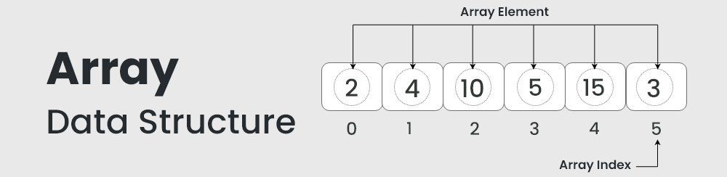
Introduction to Arrays
Arrays are foundational linear data structures.
Homogeneous collection of elements.
Stored in contiguous memory.
Accessed by Index. Ex. Arr[3] will give 10.

Slide 8
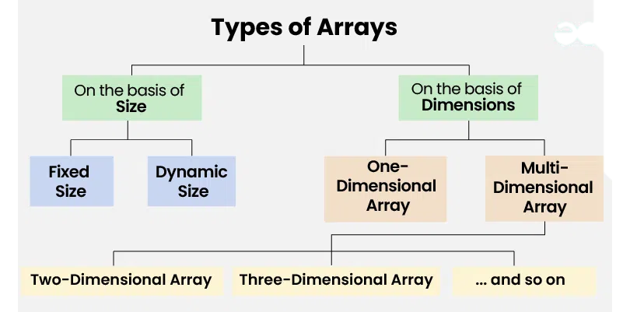
Types of Arrays

Slide 9
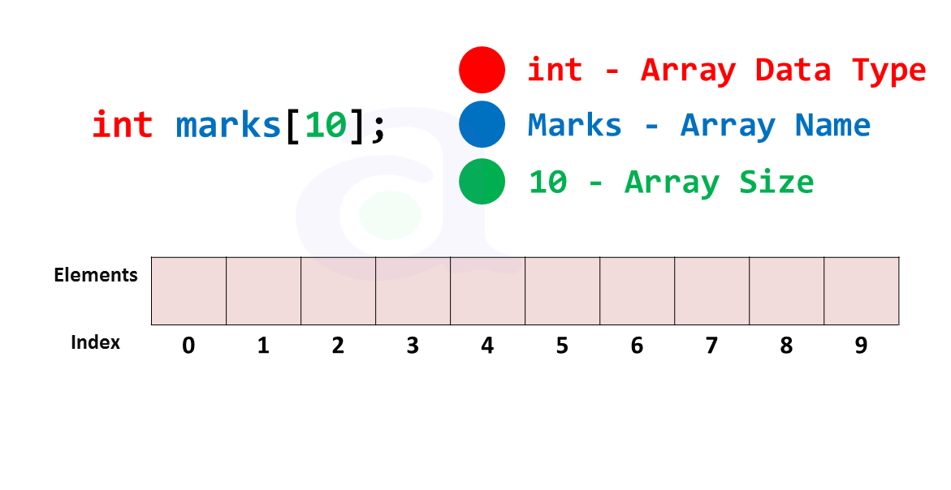
Creating 1D Arrays in C

Slide 10
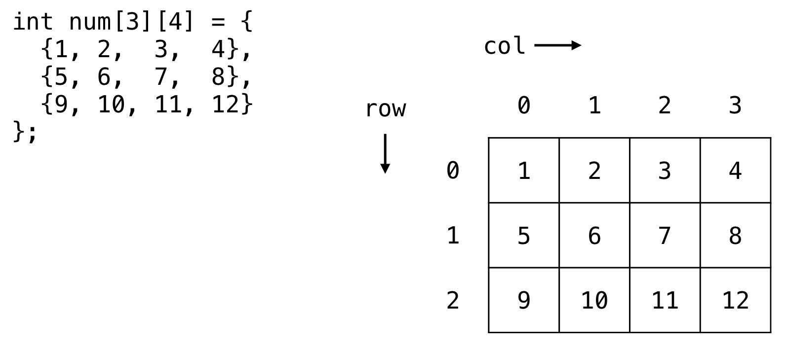
Creating 2D Arrays in C

Slide 11
Activity: Gallery Walk
1. Marks of Students: Store marks of 40 students in one subject.
2. Weekly Timetable: 7 days × 6 periods per day.
3. Image Storage: Height × Width × RGB values.
4. Weather Data: Daily temperature readings for 365 days.
5. Rubik’s Cube: 3D coordinates (x, y, z) with colors.
6. Student Records: Roll number, name, and 5 subject marks of 50 students.
7. Cinema Seat Booking : 15 rows × 20 columns.
8. Video Storage: Frames of video, each frame = image (Height × Width × RGB).
9. Hospital Patient Data: Ward × Bed × Health parameters.
Step 1: Group Task (5 min)
Upon choosing the scenario corresponds to Group ID,
Each group uses White Board to:
Justify which array dimension fits best (1D, 2D, 3D, etc.).
Step 2: Gallery Walk (10 min)
Groups rotate around the room. Read each group’s explanation. Leave sticky notes/comments:
Do you agree with the chosen array dimension?
Can you think of another way to represent it?

Slide 12
Activity: Gallery Walk
Reflection on Activity
Scenario | Description | Array Type
Marks of Students | Store marks of 40 students in one subject | 1D Array
Weekly Timetable | 7 days × 6 periods per day | 2D Array
Image Storage | Height × Width × RGB values | 3D Array
Weather Data | Daily temperature readings for 365 days | 1D Array
Rubik’s Cube | 3D coordinates (x, y, z) with colors | 3D Array
Student Records | Roll number, name, and 5 subject marks of 50 students | 2D Array
Cinema Seat Booking | 15 rows × 20 columns | 2D Array
Video Storage | Frames of video, each frame = image (Height × Width × RGB) | 4D Array
Hospital Patient Data | Ward × Bed × Health parameters | 3D Array

Slide 13
Array Traversal
1 D Arrays
2 D Arrays
int arr[5] = {10, 20, 30, 40, 50};
for (int i = 0; i < 5; i++) {
printf("%d ", arr[i]); // Visit element one by one
}
A 1D array is like a row of boxes in memory.
Traversal ➔ go from left to right.
int arr[2][3] = {{1, 2, 3}, {4, 5, 6}};
for (int i = 0; i < 2; i++) { // Loop over rows
for (int j = 0; j < 3; j++) { // Loop over columns
printf("%d ", arr[i][j]); //Visit element row by row
}
}
A 2D array is like a grid (matrix).
Traversal = row-by-row (row-major) or column-by-column (column-major).
In C row-major order is the default.

Slide 14
Row Major and Column Major Order
Row Major Order:
Row major ordering assigns successive elements, moving across the rows and then down the next row, to successive memory locations. In simple language, the elements of an array are stored in a Row-Wise fashion.
Column Major Order:
If elements of an array are stored in a column-major fashion means moving across the column and then to the next column then it’s in column-major order.

Slide 15
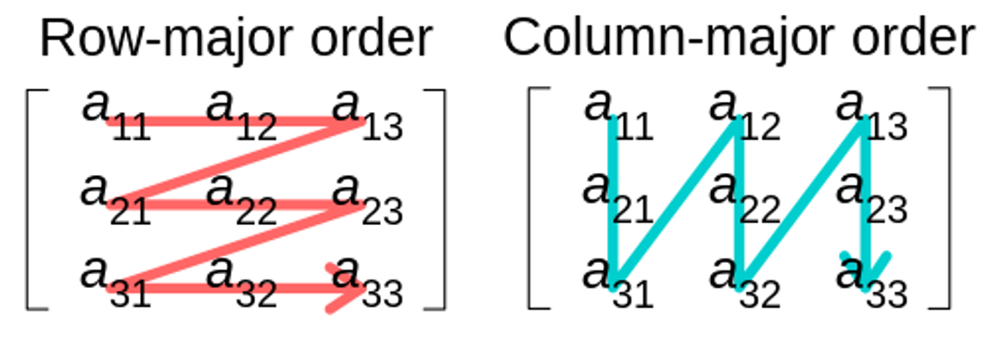
Row Major and Column Major Order

Slide 16
Row Major vs Column Major Traversal
for (int i = 0; i < rows; i++) {
for (int j = 0; j < cols; j++) {
printf("%d ", A[i][j]); // Visit element row-wise
}
}
for (int j = 0; j < cols; j++) {
for (int i = 0; i < rows; i++) {
printf("%d ", A[i][j]); // Visit element column-wise
}
}

Slide 17


Slide 18
Post-Class Assessment
[2-mins]
https://app.wooflash.com/moodle/Q3OA6WUY
Wooflash Code: Q3OA6WUY
Join the link and Participate in Post-class Assessment

Slide 19
Summary
[1-mins]

Slide 20
[2-mins]
Ensure attainment of LO’s in alignment to the learning activities:
Explain single and multidimensional arrays with examples
Differentiate row-major and column-major array representation

Slide 21
[1-min]
Next Session:
Derivation of Index Formulae for 1-D,2-D, and multi-D Array

Slide 22
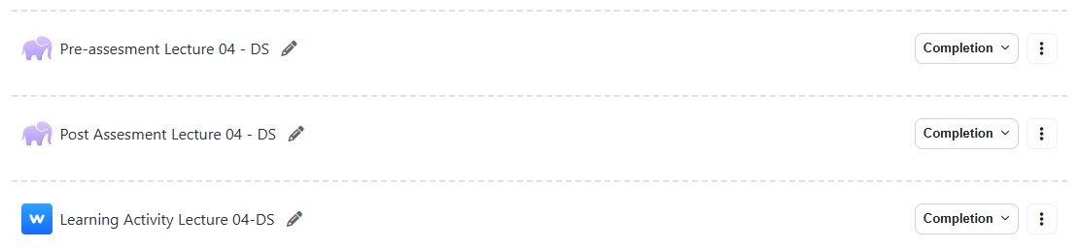
Review and Reflection from students

